Slide 1
OpenACC Course
Lecture 1: Introduction to OpenACC
September 2015

Slide 2
Course Objective: Enable you to accelerate your applications with OpenACC.

Slide 3
Oct 1: Introduction to OpenACC
Oct 6: Office Hours
Oct 15: Profiling and Parallelizing with the OpenACC Toolkit
Oct 20: Office Hours
Oct 29: Expressing Data Locality and Optimizations with OpenACC
Nov 3: Office Hours
Nov 12: Advanced OpenACC Techniques
Nov 24: Office Hours
Course Syllabus
Recordings: https://developer.nvidia.com/openacc-course

Slide 4
Introduction to OpenACC
Jeff Larkin, NVIDIA Developer Technologies

Slide 5
Why OpenACC?
Accelerated Computing Fundamentals
OpenACC Programming Cycle
Installing the OpenACC Toolkit
Accessing QwikLabs
Week 1 Homework
Agenda

Slide 6
Why OpenACC?

Slide 7
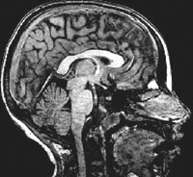


main()
{
<serial code>
#pragma acc kernels
//automatically runs on GPU
{
<parallel code>
}
}
University of Illinois
PowerGrid- MRI Reconstruction
OpenACC
Simple | Powerful | Portable
Fueling the Next Wave of
Scientific Discoveries in HPC
70x Speed-Up
2 Days of Effort
8000+
Developers
using OpenACC
RIKEN Japan
NICAM- Climate Modeling
7-8x Speed-Up
5% of Code Modified
http://www.cray.com/sites/default/files/resources/OpenACC_213462.12_OpenACC_Cosmo_CS_FNL.pdf
http://www.hpcwire.com/off-the-wire/first-round-of-2015-hackathons-gets-underway
http://on-demand.gputechconf.com/gtc/2015/presentation/S5297-Hisashi-Yashiro.pdf
http://www.openacc.org/content/experiences-porting-molecular-dynamics-code-gpus-cray-xk7
Notes:
So we know that developers drive innovation in HPC. There is a programming tool that we believe will fuel the next wave of developers in HPC. OpenACC.
Industry standard programming interface that makes it simpler than ever to run existing codes on the accelerator.
relying on a compiler to do most of the hard work, to automatically run code on the GPU.
Targets developers, mostly domain scientists w/o any computer science background. No parallel programming background.
With OpenACC, domain scientists don’t have to master parallel programming.
By putting simple hints into the code that a compiler can understand, the compiler does parallel programming on behalf of the developer.
<refer to the green box>
Today, over 8000 developers are using OpenACC.
Many of those who have used OpenACC have had great success.
Examples underscore the fact that OpenACC is simple. Only 5% of the code was modified. Only 2 days of effort for PowerGrid.
At the same time, OpenACC is powerful. 7-8x speedup on their code. Even up to 70x over CPU code.
PowerGrid - MRI Reconstruction Information
=========
Advanced model for MRI reconstruction.
Two approaches:
1. DFT - O(N^2), simple but compute intensive. Use for extremely under-sampled acquisitions. Would be a new approach. Less radiation dosage.
2. Gridding DFT approximation, O(N log(N)), several steps; predominant approach used in existing scanners today. Less computationally intensive.
With OpenACC, they feel that DFT is now possible
DFT is 88% forward and inverse Fourier Transforms on CPU. App threaded for 2 cores but doesn't scale.
OpenACC: In DFT routines added 2 lines and achieved a 70x speedup
DFT run (reconstruct 3000 images) on BW ran in 21.2 hours last night vs. 9 months on CPU!
Take-aways:
2 lines of code. Using DFT is now feasible; could move from research to diagnostic with some refinement.

Slide 8
Minimal Effort
LS-DALTON
Large-scale application for calculating high-accuracy molecular energies
Lines of Code Modified
# of Weeks Required
# of Codes to Maintain
<100 Lines
1 Week
1 Source
Big Performance
LS-DALTON CCSD(T) Module
Benchmarked on Titan Supercomputer (AMD CPU vs Tesla K20X)
“
OpenACC makes GPU computing approachable for domain scientists. Initial OpenACC implementation required only minor effort, and more importantly,
no modifications of our existing CPU implementation.
“
Janus Juul Eriksen, PhD Fellow
qLEAP Center for Theoretical Chemistry, Aarhus University
Notes:
A story of a domain scientist who captures the target audience for OpenACC Toolkit.
Background
Research team based at Aarhus University working on LS-Dalton application,
The goal is to provide the scientific community with a tool for screening between different large-scale molecular as well as assisting experimental work on molecular wires/nanowires (these conduct electrical current and act as fundamental building blocks for new molecular electronic devices).
Because they are one of the leading apps in this area, was recently awarded significant time on both Titan and Summit supercomputers.
Problem
LS-DALTON is an application developed over a long period of time with numerous quantum chemical methods, and Janus, a phD student, was asked to maintain it.
Janus has no formal education in computer science. He taught himself basic Fortran in order to do more science through simulation.
Need to re-write the application to run on large-scale supercomputers. But the code needs to be easy to write and extend & maintain by others.
Solution
OpenACC enabled Janus to accelerate LS-DALTON in a matter of a few days, requiring minimal work without rewriting the underlying algorithm.
With OpenACC, the original source code is kept in-tact, making the implementation intuitively transparent.
OpenACC leaves most of the hard work to the compiler, allowing domain scientists like Janus to focus his energy on science, not programming.
Benefit
Important algorithms in LS-DALTON is seeing up to 12x speed-up compared to CPU-only code. This enables the research team to run larger molecular structures at higher accuracy, ultimately accelerating discoveries in materials and quantum chemistry.
The team was awarded significant time on the upcoming Summit supercomputer at Oak Ridge.

Slide 9


OpenACC Directives
#pragma acc data copyin(a,b) copyout(c) { ... #pragma acc parallel
{
#pragma acc loop gang vector
for (i = 0; i < n; ++i) {
z[i] = x[i] + y[i];
...
}
}
...
}
Manage Data Movement
Incremental
Single source
Initiate Parallel Execution
Interoperable
Performance portable
CPU, GPU, MIC
Optimize
Loop Mappings
Notes:
Are you new to OpenACC? Here is a quick primer. [Here’s is quick refresher.]
You can take large existing applications, and incrementally parallelize compute-intensive loops and routines for offloading to an Accelerator.
OpenACC allows you to keep one copy of your source code, because the directives are ignored by any compiler that doesn’t understand them – that means your code remains completely portable for use with any standard C, C++ or Fortran compiler.
OpenACC is designed to be interoperable with explicit accelerator parallel programming models like CUDA and OpenCL, which means you can directly call library routines written in those programming models from your OpenACC program and if needed you can code the really important parts of your program in those lower-level models if you need to.
OpenACC was designed from the outset to be performance portable, so that you can write programs that will map efficiently to multi-core CPUs, GPUs from NVIDIA or AMD, or many integrated core (MIC) accelerators like the upcoming Knights Landing processors from Intel.

Slide 10
Accelerated Computing Fundamentals

Slide 11



Accelerated Computing 10x Performance & 5x Energy Efficiency for HPC
GPU Accelerator
Optimized for
Parallel Tasks
CPU
Optimized for
Serial Tasks

Slide 12


What is Heterogeneous Programming?
Application Code
Compute-Intensive Functions
Rest of Sequential
CPU Code
A few % of Code
A large % of Time
GPU
CPU
+

Slide 13
Portability & Performance
Portability
Accelerated Libraries
High performance with little or no code change
Limited by what libraries are available
Compiler Directives
High Level: Based on existing languages; simple, familiar, portable
High Level: Performance may not be optimal
Parallel Language Extensions
Greater flexibility and control for maximum performance
Often less portable and more time consuming to implement
Performance

Slide 14
Code for Portability & Performance
Libraries
Implement as much as possible using portable libraries
Directives
Use directives for rapid and portable development
Languages
Use lower level languages for important kernels

Slide 15
OpenACC Programming Cycle

Slide 16
Identify Available Parallelism
Express Parallelism
Express Data Movement
Optimize Loop Performance

Slide 17
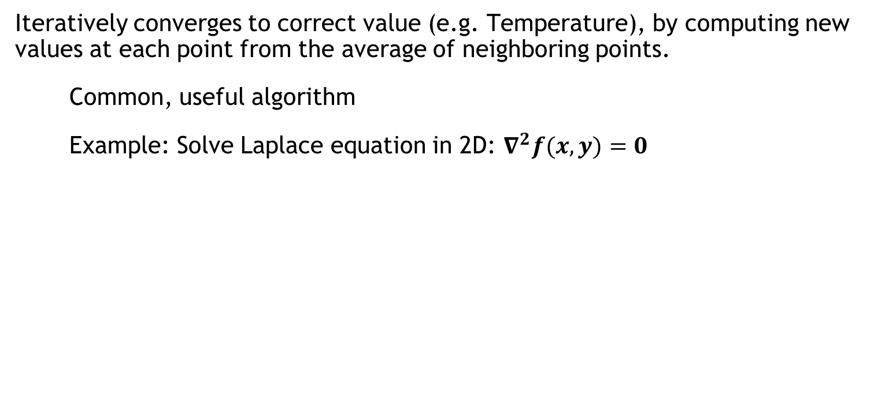
Example: Jacobi Iteration
Iteratively converges to correct value (e.g. Temperature), by computing new values at each point from the average of neighboring points.
Common, useful algorithm
Example: Solve Laplace equation in 2D: $∇^{2}f(x,y)=0$
A(i,j+1)
A(i-1,j)
A(i+1,j)
A(i,j)
$$A_{k+1}\left(i,j\right)=\frac{A_{k}(i−1,j)+A_{k}\left(i+1,j\right)+A_{k}\left(i,j−1\right)+A_{k}\left(i,j+1\right) }{4}$$
A(i,j-1)

Slide 18
Jacobi Iteration: C Code
Iterate until converged
while ( err > tol && iter < iter_max ) {
err=0.0;
for( int j = 1; j < n-1; j++) {
for(int i = 1; i < m-1; i++) {
Anew[j][i] = 0.25 * (A[j][i+1] + A[j][i-1] +
A[j-1][i] + A[j+1][i]);
err = max(err, abs(Anew[j][i] - A[j][i]));
}
}
for( int j = 1; j < n-1; j++) {
for( int i = 1; i < m-1; i++ ) {
A[j][i] = Anew[j][i];
}
}
iter++;
}
Iterate across matrix elements
Calculate new value from neighbors
Compute max error for convergence
Swap input/output arrays

Slide 19
Identify Available Parallelism
Express Parallelism
Express Data Movement
Optimize Loop Performance

Slide 20
Identify Parallelism
Data dependency between iterations.
while ( err > tol && iter < iter_max ) {
err=0.0;
for( int j = 1; j < n-1; j++) {
for(int i = 1; i < m-1; i++) {
Anew[j][i] = 0.25 * (A[j][i+1] + A[j][i-1] +
A[j-1][i] + A[j+1][i]);
err = max(err, abs(Anew[j][i] - A[j][i]));
}
}
for( int j = 1; j < n-1; j++) {
for( int i = 1; i < m-1; i++ ) {
A[j][i] = Anew[j][i];
}
}
iter++;
}
Independent loop iterations
Independent loop iterations

Slide 21
Identify Available Parallelism
Express Parallelism
Express Data Movement
Optimize Loop Performance

Slide 22
OpenACC kernels Directive
The kernels directive identifies a region that may contain loops that the compiler can turn into parallel kernels.
#pragma acc kernels
{
for(int i=0; i<N; i++)
{
x[i] = 1.0;
y[i] = 2.0;
}
for(int i=0; i<N; i++)
{
y[i] = a*x[i] + y[i];
}
}
The compiler identifies 2 parallel loops and generates 2 kernels.
kernel 1
kernel 2
Notes:
Note: The term “kernel” should be explained briefly, but will be explained in more depth in the second lecture.

Slide 23
Parallelize with OpenACC kernels
while ( err > tol && iter < iter_max ) {
err=0.0;
#pragma acc kernels
{
for( int j = 1; j < n-1; j++) {
for(int i = 1; i < m-1; i++) {
Anew[j][i] = 0.25 * (A[j][i+1] + A[j][i-1] +
A[j-1][i] + A[j+1][i]);
err = max(err, abs(Anew[j][i] - A[j][i]));
}
}
for( int j = 1; j < n-1; j++) {
for( int i = 1; i < m-1; i++ ) {
A[j][i] = Anew[j][i];
}
}
}
iter++;
}
Look for parallelism within this region.

Slide 24
Building the code
$ pgcc -fast -ta=tesla -Minfo=all laplace2d.c
main:
40, Loop not fused: function call before adjacent loop
Generated vector sse code for the loop
51, Loop not vectorized/parallelized: potential early exits
55, Generating copyout(Anew[1:4094][1:4094])
Generating copyin(A[:][:])
Generating copyout(A[1:4094][1:4094])
Generating Tesla code
57, Loop is parallelizable
59, Loop is parallelizable
Accelerator kernel generated
57, #pragma acc loop gang /* blockIdx.y */
59, #pragma acc loop gang, vector(128) /* blockIdx.x threadIdx.x */
63, Max reduction generated for error
67, Loop is parallelizable
69, Loop is parallelizable
Accelerator kernel generated
67, #pragma acc loop gang /* blockIdx.y */
69, #pragma acc loop gang, vector(128) /* blockIdx.x threadIdx.x */

Slide 25
Intel Xeon E5-2698 v3 @ 2.30GHz (Haswell)
vs.
NVIDIA Tesla K40
Why did OpenACC slow down here?

Slide 26
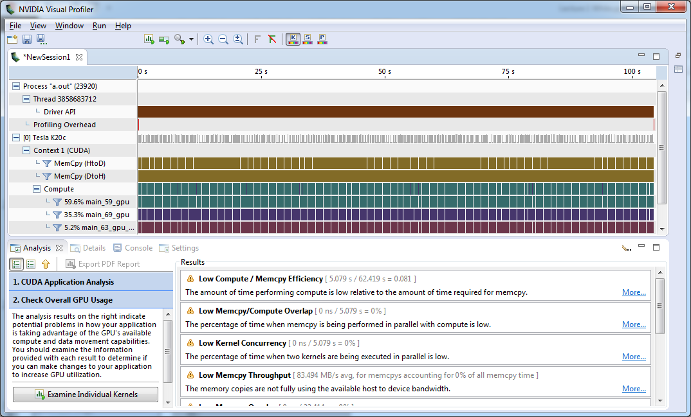
Very low Compute/Memcpy ratio
Compute | 5 seconds
Memory Copy | 62 seconds

Slide 27
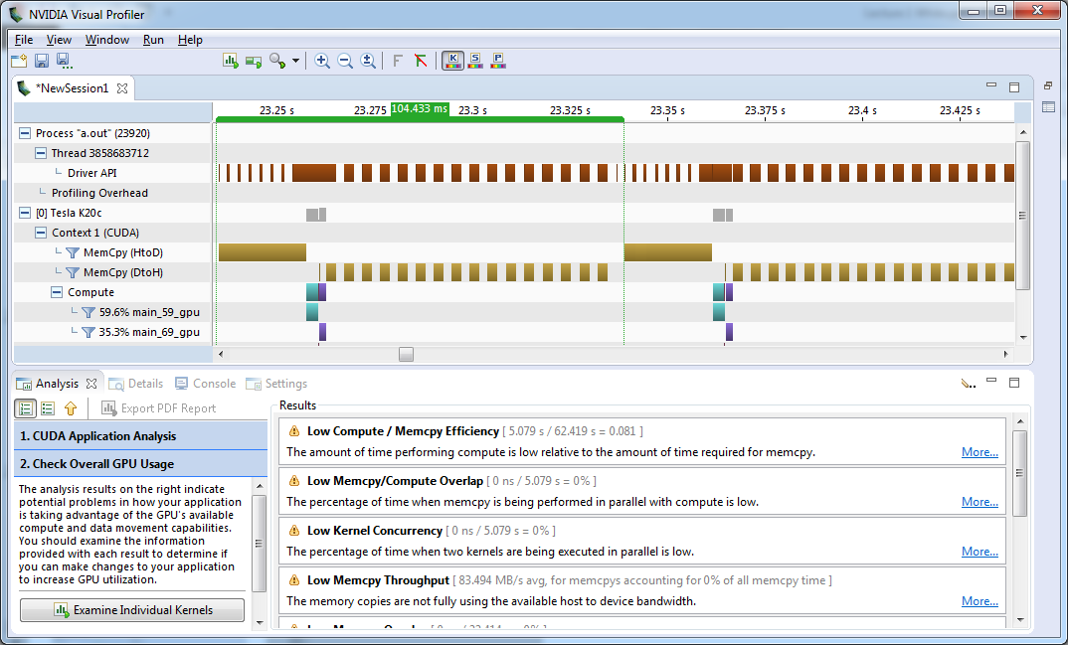
104ms/iteration
PCIe Copies

Slide 28
Excessive Data Transfers
while ( err > tol && iter < iter_max ) {
err=0.0;
...
}
#pragma acc kernels
for( int j = 1; j < n-1; j++) {
for(int i = 1; i < m-1; i++) {
Anew[j][i] = 0.25 * (A[j][i+1] +
A[j][i-1] + A[j-1][i] +
A[j+1][i]);
err = max(err, abs(Anew[j][i] –
A[j][i]);
}
}
...
A, Anew resident on host
A, Anew resident on accelerator
Copy
These copies happen every iteration of the outer while loop!
Copy
A, Anew resident on host
A, Anew resident on accelerator
Notes:
STOP FOR QUESTIONS.
How might you address this problem?

Slide 29
Identifying Data Locality
while ( err > tol && iter < iter_max ) {
err=0.0;
#pragma acc kernels
{
for( int j = 1; j < n-1; j++) {
for(int i = 1; i < m-1; i++) {
Anew[j][i] = 0.25 * (A[j][i+1] + A[j][i-1] +
A[j-1][i] + A[j+1][i]);
err = max(err, abs(Anew[j][i] - A[j][i]));
}
}
for( int j = 1; j < n-1; j++) {
for( int i = 1; i < m-1; i++ ) {
A[j][i] = Anew[j][i];
}
}
}
iter++;
}
Does the CPU need the data between these loop nests?
Does the CPU need the data between iterations of the convergence loop?

Slide 30
Identify Available Parallelism
Express Parallelism
Express Data Movement
Optimize Loop Performance

Slide 31
Data regions
The data directive defines a region of code in which GPU arrays remain on the GPU and are shared among all kernels in that region.
#pragma acc data
{
#pragma acc kernels
...
#pragma acc kernels
...
}
Arrays used within the data region will remain on the GPU until the end of the data region.
Data Region

Slide 32
Data Clauses
copy ( list ) | Allocates memory on GPU and copies data from host to GPU when entering region and copies data to the host when exiting region.
copyin ( list ) | Allocates memory on GPU and copies data from host to GPU when entering region.
copyout ( list ) | Allocates memory on GPU and copies data to the host when exiting region.
create ( list ) | Allocates memory on GPU but does not copy.
present ( list ) | Data is already present on GPU from another containing data region.
deviceptr( list ) | The variable is a device pointer (e.g. CUDA) and can be used directly on the device.

Slide 33
Array Shaping
Compiler sometimes cannot determine size of arrays
Must specify explicitly using data clauses and array “shape”
C/C++
#pragma acc data copyin(a[0:nelem]) copyout(b[s/4:3*s/4])
Fortran
!$acc data copyin(a(1:end)) copyout(b(s/4:3*s/4))
Note: data clauses can be used on data, parallel, or kernels

Slide 34
Express Data Locality
Copy A to/from the accelerator only when needed.
Create Anew as a device temporary.
#pragma acc data copy(A) create(Anew)
while ( err > tol && iter < iter_max ) {
err=0.0;
#pragma acc kernels
{
for( int j = 1; j < n-1; j++) {
for(int i = 1; i < m-1; i++) {
Anew[j][i] = 0.25 * (A[j][i+1] + A[j][i-1] +
A[j-1][i] + A[j+1][i]);
err = max(err, abs(Anew[j][i] - A[j][i]));
}
}
for( int j = 1; j < n-1; j++) {
for( int i = 1; i < m-1; i++ ) {
A[j][i] = Anew[j][i];
}
}
}
iter++;
}

Slide 35
Rebuilding the code
$ pgcc -fast -acc -ta=tesla -Minfo=all laplace2d.c
main:
40, Loop not fused: function call before adjacent loop
Generated vector sse code for the loop
51, Generating copy(A[:][:])
Generating create(Anew[:][:])
Loop not vectorized/parallelized: potential early exits
56, Accelerator kernel generated
56, Max reduction generated for error
57, #pragma acc loop gang /* blockIdx.x */
59, #pragma acc loop vector(256) /* threadIdx.x */
56, Generating Tesla code
59, Loop is parallelizable
67, Accelerator kernel generated
68, #pragma acc loop gang /* blockIdx.x */
70, #pragma acc loop vector(256) /* threadIdx.x */
67, Generating Tesla code
70, Loop is parallelizable

Slide 36
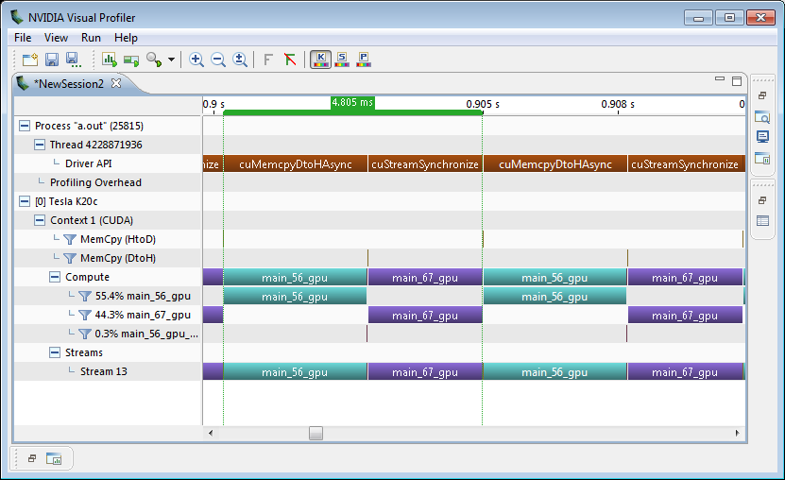
Visual Profiler: Data Region
Was 104ms
Iteration 1
Iteration 2

Slide 37
Intel Xeon E5-2698 v3 @ 2.30GHz (Haswell)
vs.
NVIDIA Tesla K40

Slide 38
Identify Available Parallelism
Express Parallelism
Express Data Movement
Optimize Loop Performance

Slide 39
The loop Directive
The loop directive gives the compiler additional information about the next loop in the source code through several clauses.
independent – all iterations of the loop are independent
collapse(N) – turn the next N loops into one, flattened loop
tile(N[,M,…]) - break the next 1 or more loops into tiles based on the provided dimensions.
These clauses and more will be discussed in greater detail in a later class.

Slide 40
Optimize Loop Performance
#pragma acc data copy(A) create(Anew)
while ( err > tol && iter < iter_max ) {
err=0.0;
#pragma acc kernels
{
#pragma acc loop device_type(nvidia) tile(32,4)
for( int j = 1; j < n-1; j++) {
for(int i = 1; i < m-1; i++) {
Anew[j][i] = 0.25 * (A[j][i+1] + A[j][i-1] +
A[j-1][i] + A[j+1][i]);
err = max(err, abs(Anew[j][i] - A[j][i]));
}
}
#pragma acc loop device_type(nvidia) tile(32,4)
for( int j = 1; j < n-1; j++) {
for( int i = 1; i < m-1; i++ ) {
A[j][i] = Anew[j][i];
}
}
}
iter++;
}
“Tile” the next two loops into 32x4 blocks, but only on NVIDIA GPUs.

Slide 41
Intel Xeon E5-2698 v3 @ 2.30GHz (Haswell)
vs.
NVIDIA Tesla K40

Slide 42
The OpenACC Toolkit

Slide 43

Introducing the New OpenACC Toolkit
Free Toolkit Offers Simple & Powerful Path to Accelerated Computing
PGI Compiler
Free OpenACC compiler for academia
NVProf Profiler
Easily find where to add compiler directives
GPU Wizard
Identify which GPU libraries can jumpstart code
Code Samples
Learn from examples of real-world algorithms
http://developer.nvidia.com/openacc
Documentation
Quick start guide, Best practices, Forums
Notes:
We think every domain scientist should have access to this powerful tool. So what we are announcing today is a new toolkit called, the NVIDIA OpenACC Toolkit.
It’s everything a developer needs for quick on-ramp to accelerated computing.
The foundation of this toolkit is a free OpenACC compiler.
Up to now, anyone who wanted to try OpenACC would have had to pay for the compiler.
In partnering with PGI, one of the leading compiler vendor in HPC, we’ve eliminated that barrier to access. Free for academia.
Toolkit includes NVProf profiler which helps developers locate where to insert the compiler hints
Lots of samples of how to use OpenACC in real-world algorithms so developer can just cut and paste
Quick start guide, best practices guide. Other tools that help make developer experience as seamless as possible
We’re really excited about this toolkit. Developers can spend less time programming, and more time doing science
Starting 7/13, any developer can download the toolkit from URL

Slide 44
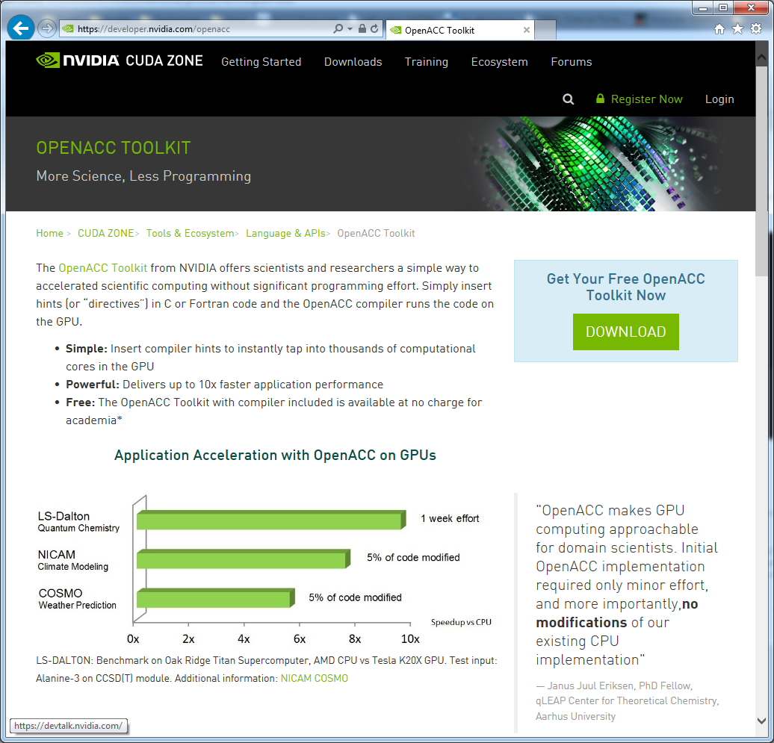
Download the OpenACC Toolkit
Go to https://developer.nvidia.com/openacc

Slide 45

Download the OpenACC Toolkit
Go to https://developer.nvidia.com/openacc
Register for the toolkit
If you are an academic developer, be sure to click the check box at the bottom.

Slide 46
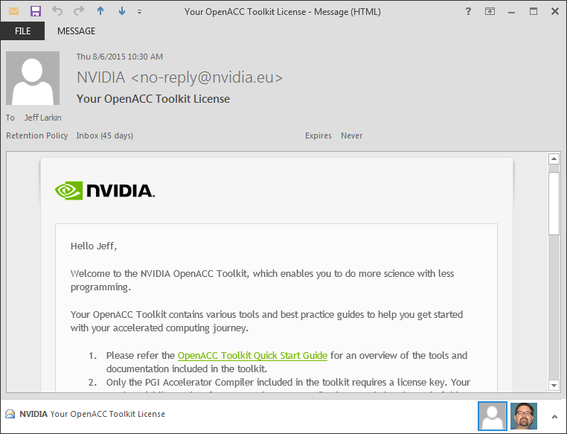
Download the OpenACC Toolkit
Go to https://developer.nvidia.com/openacc
Register for the toolkit
If you are an academic developer, be sure to click the check box at the bottom.
You will receive an email from NVIDIA
Be sure to read the Quick Start Guide

Slide 47
Windows/Mac Developers
The OpenACC Toolkit is only available on Linux, however…
The PGI compiler is available on Mac and Windows from http://www.pgroup.com/support/trial.htm
You should still register for the OpenACC Toolkit to get the 90 day license.
The CUDA Toolkit contains the libraries and profiling tools that will be used in this course.
https://developer.nvidia.com/cuda-zone
The OpenACC Programming Guide is available from http://bit.ly/openacc-guide
Obtaining all examples and guides from the toolkit will still require downloading the full OpenACC toolkit.

Slide 48
Using QwikLabs

Slide 49
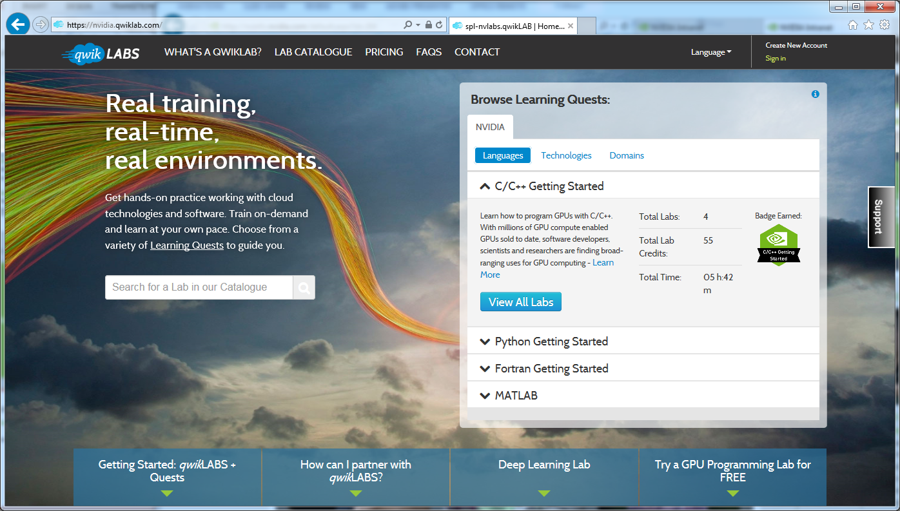
Getting access
Sign In or Create a New Account
Go to nvidia.qwiklab.com, log-in or create an account

Slide 50
Homework

Slide 51
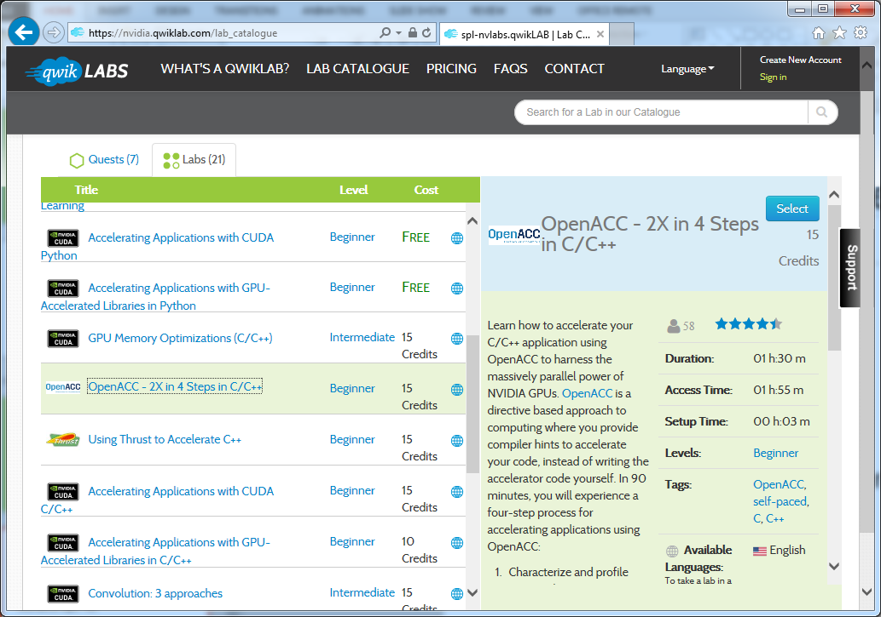
Complete “2X in 4 Steps” Qwiklab
C: http://bit.ly/nvoacclab1c
F90: http://bit.ly/nvoacclab1f
This lab is browser-based and should take you roughly 1 hour.

Slide 52
Install the OpenACC Toolkit (Optional)
Go to developer.nvidia.com/openacc
Register for the OpenACC Toolkit
Install on your personal machine. (Linux Only)

Slide 53
Where to find help
OpenACC Course Recordings - https://developer.nvidia.com/openacc-course
OpenACC on StackOverflow - http://stackoverflow.com/questions/tagged/openacc
OpenACC Toolkit - http://developer.nvidia.com/openacc
Additional Resources:
Parallel Forall Blog - http://devblogs.nvidia.com/parallelforall/
GPU Technology Conference - http://www.gputechconf.com/
OpenACC Website - http://openacc.org/

Slide 54
Oct 1: Introduction to OpenACC
Oct 6: Office Hours
Oct 15: Profiling and Parallelizing with the OpenACC Toolkit
Oct 20: Office Hours
Oct 29: Expressing Data Locality and Optimizations with OpenACC
Nov 3: Office Hours
Nov 12: Advanced OpenACC Techniques
Nov 24: Office Hours
Course Syllabus
Recordings: https://developer.nvidia.com/openacc-course

